Slide 1

Object Tracking for Safety
Computer Vision Final Project
Team SafeBot: SAPTADEEP DEBNATH
PREETI KANNAPAN
MALVIKA SHETTY

Slide 2
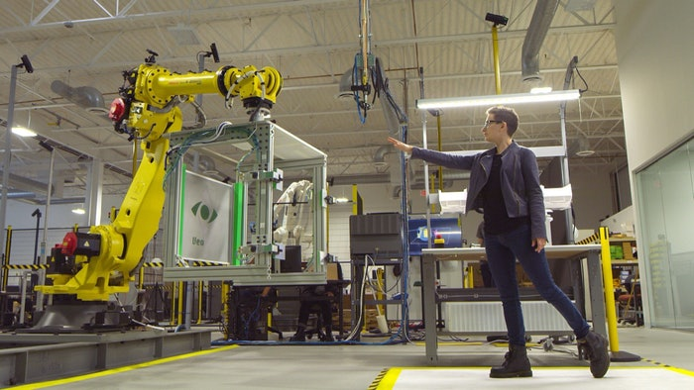
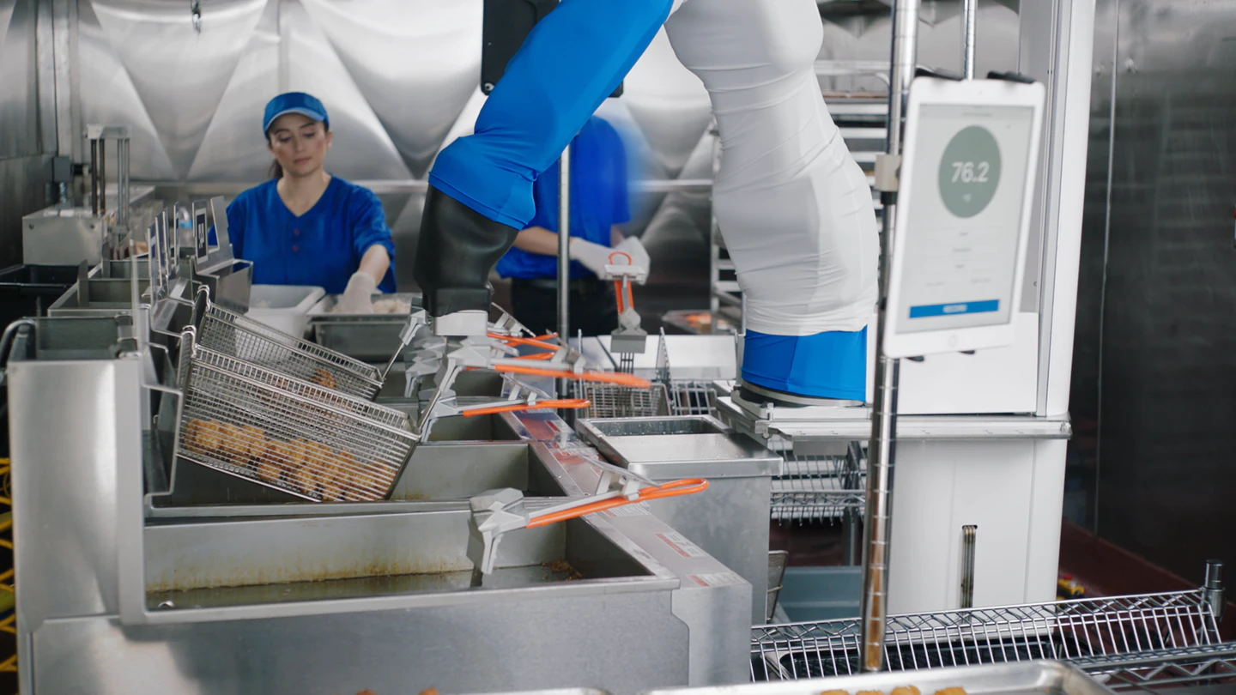
Motivation
Deployment of autonomous robots and vehicles
Highly dynamic environments can lead to hazardous situations
Humans gauge danger instinctively, while robots do not
Even with IR, robots are nearsighted
Safety of humans in these situations is critical

Slide 3
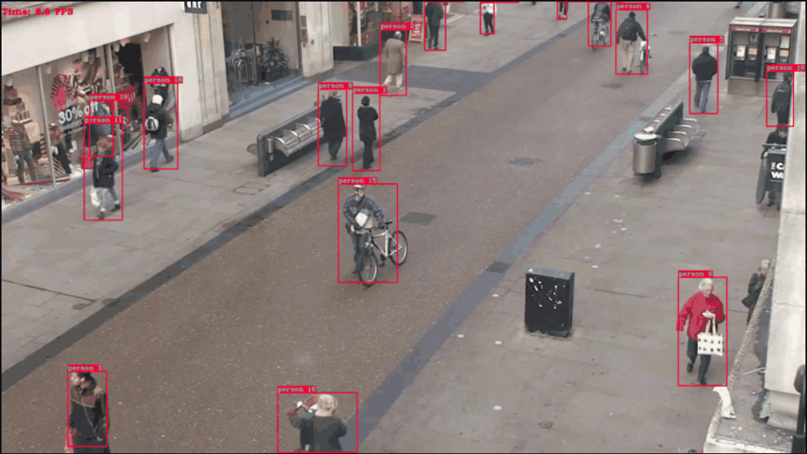
Idea
A safety warning system that makes use of multi-object tracking with bounding boxes to issue warnings before possible collisions among objects in a scene of interest
Multi-object tracking
YOLO for object detection
DeepSORT for tracking
Safety module
Position and velocity tracking w.r.t. the camera frame
Safety conditions
Warning

Slide 4
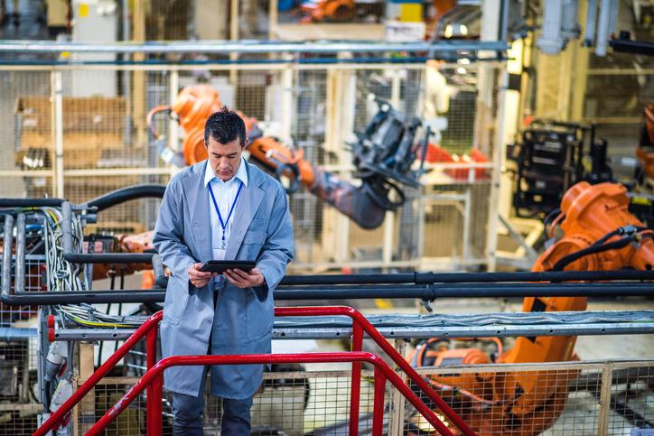
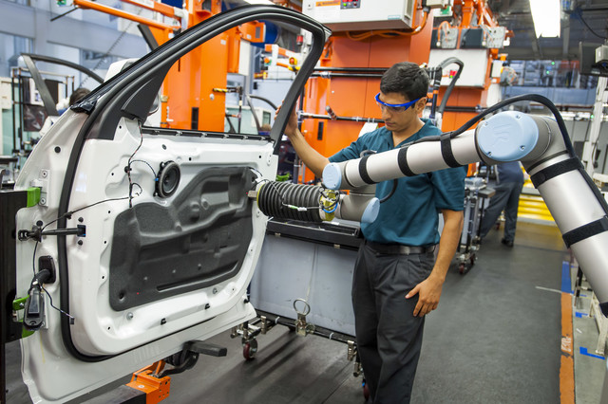
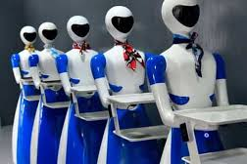
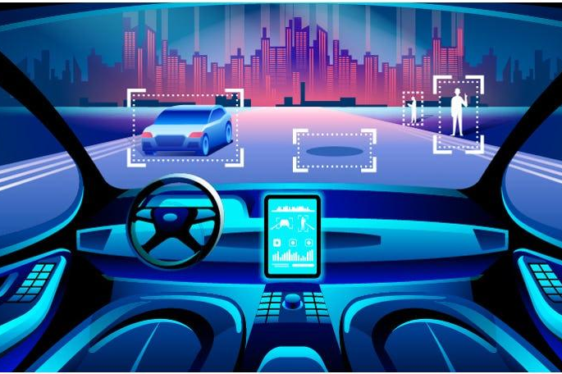
Impact on Society
As an external device:
Large field of view
Examples -
Industrial robots
Collaborative robots
Service robots
As a mounted device:
Object reaction
Example -
Autonomous vehicles

Slide 5
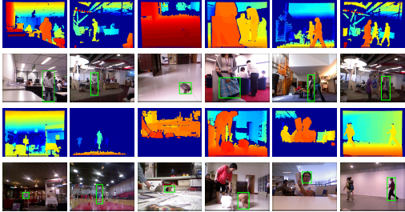
Dataset
Princeton Tracking Benchmark (RGB-D): http://tracking.cs.princeton.edu/dataset.html
RGB Folder: 8-bit PNG
Depth Folder: 16-bit PNG
First 3 bit swap to the last
frames.json
Intrinsic Camera Parameters:
K : 3x3 intrinsic matrix
fov: field of view
Video Length
RGB image Timestamps
RGB image Frame IDs
Depth image Timestamps
Depth image Frame IDs
We use the “Three People” Princeton Dataset for this project

Slide 6
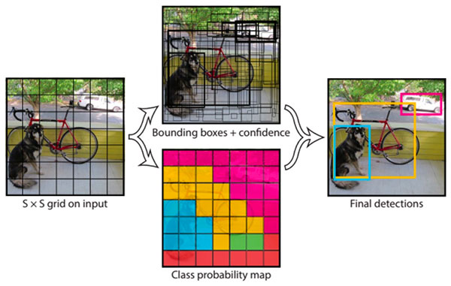
YOLOv3
Robust and fast multi-object multi-class object detection
Darknet-53 for image classification and feature extraction
COCO dataset weights used for this project

Slide 7
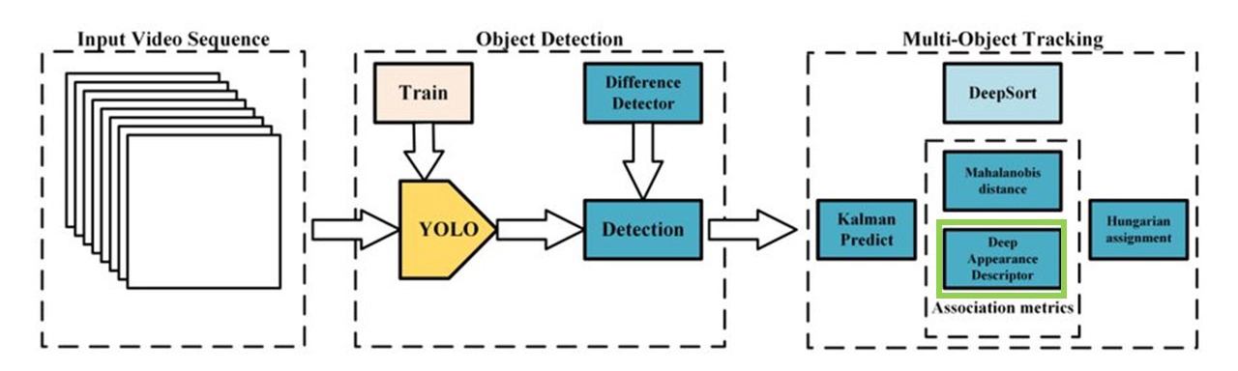
DeepSORT
Predictions using Kalman Filter
Mahalanobis distance and cosine distance between the appearance feature vector

Slide 8
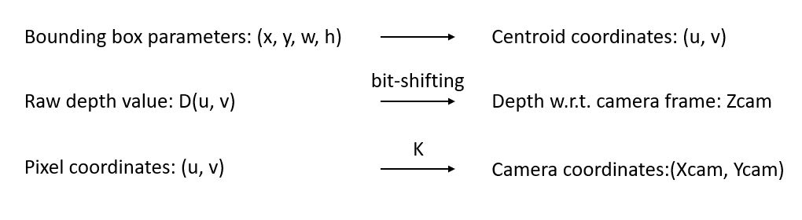
Safety Module
The following transforms were applied to obtain object positions in camera coordinates:
The instantaneous velocities of each object are calculated using their positions in the current and previous frames, and the frame rate

Slide 9
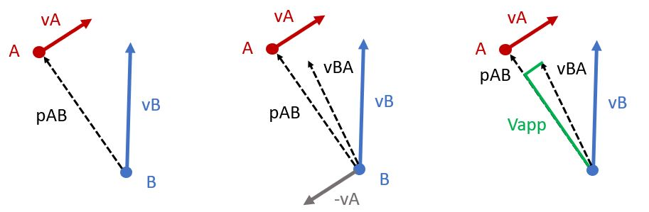
Safety Module
Relative position and velocity vectors between each pair of objects is used to evaluate the following safety conditions:
Condition 1: Far away but approaching fast
p_{AB} > distance tolerance AND V_{app} > approaching tolerance => “APPROACHING” warning
Condition 2: Close-by and approaching fast
p_{AB} <= distance tolerance AND V_{app} > approaching tolerance => “DANGER” warning

Slide 10
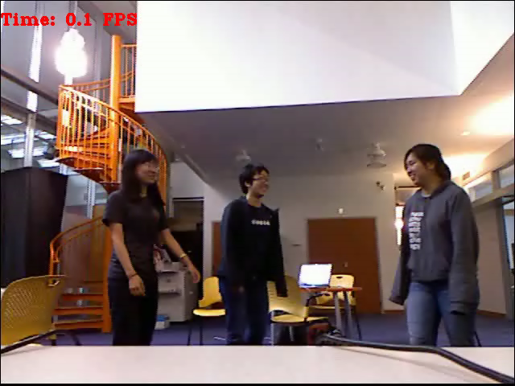
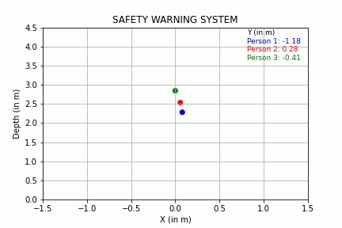
Prototype

Slide 11
Prototype

Slide 12
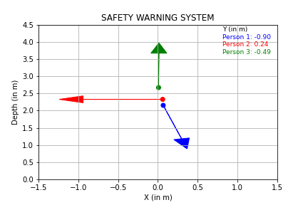
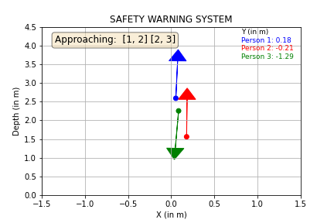
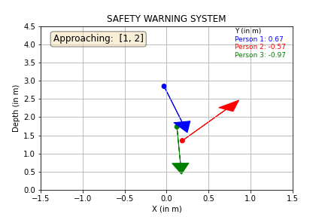
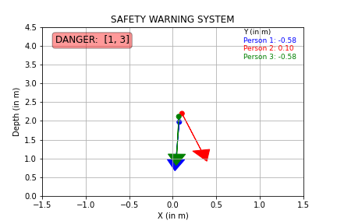
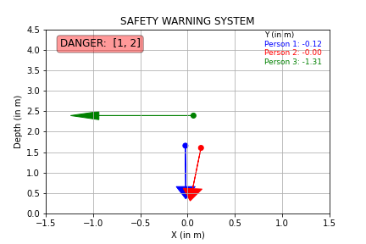
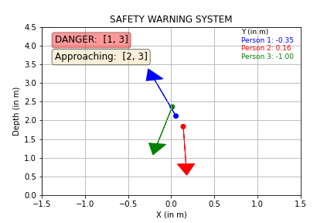
Results
Occlusion
Missing bounding boxes
Jump in position
Temporarily outdated velocity
Tolerance tuning
distance tolerance = 0.3 m
approaching velocity tolerance = 0.5 m/s
Safety conditions use relative positions and velocities:
velocity pointing at object, no warning if object is moving away fast enough
velocity not pointing at object, warning if relative distance decreasing

Slide 13
Conclusions
Successfully used YOLO toolkit on a Princeton RGBD dataset to obtain detections of ‘Person’ class
Tracked the people correctly despite occlusion issues using DeepSORT
Generated a top view video showing the positions and velocities of the tracked people w.r.t. the camera frame
Built the Safety Warning System using relative distance and velocity between tracked people
Verified the accurate performance of the Safety Warning System w.r.t. the vectors in top view video as well as the corresponding object tracking video

Slide 14
Future Work
Take into account object shape and size instead of point mass assumption
Extension to a mounted device
Trajectory tracking and prediction
for more advanced warnings - based on predictions from current trajectory
to overcome occlusion issue - missing position and velocity values
Safe reaction instructions

Slide 15
References
Redmon, J. and Farhadi, A., 2018. Yolov3: An incremental improvement.arXiv preprint arXiv:1804.02767.
Redmon, J. and Farhadi, A., 2017. Yolo9000: Better, faster, stronger.In Proceedings of the IEEE conference on computer vision and pattern recognition(pp. 7263-7271).
Lin, T.Y., Maire, M., Belongie, S., Hays, J., Perona, P., Ramanan, D., Doll ́ar, P. and Zitnick, C.L., 2014, September. Microsoft coco: Common objects in context.In European conference on computer vision (pp. 740-755). Springer, Cham.
Wojke, N. and Bewley, A., 2018, March. Deep cosine metric learning for person re-identification.In 2018 IEEE winter conference on applicationsof computer vision (WACV) (pp. 748-756). IEEE.
Wojke, N., Bewley, A. and Paulus, D., 2017, September. Simple online and realtime tracking with a deep association metric.In 2017 IEEE international conference on image processing (ICIP) (pp. 3645-3649). IEEE.
Princeton Tracking Benchmark, http://tracking.cs.princeton.edu/dataset.html

Slide 16
Thank you for listening!

